Slide 1



Home
Overview
Training
Capabilities
Contact
Join
Manufacturing Downtime Analysis
Mining the Past, Powering the Future.

Slide 2




Data Analyst Specalist Track
Under Supervision of
Instructor: Dr. Maged Magdy

Slide 3

Home
Overview
Training
Capabilities
Contact
Join
Manufacturing Downtime
Mining the Past, Powering the Future.

Slide 4






Home
Overview
Training
Capabilities
Contact
Join
Our Team
Hoda Elkassas
Hanaa Edreis
Farah Sameh
Yomna Ayman
Rania Elwan

Slide 5
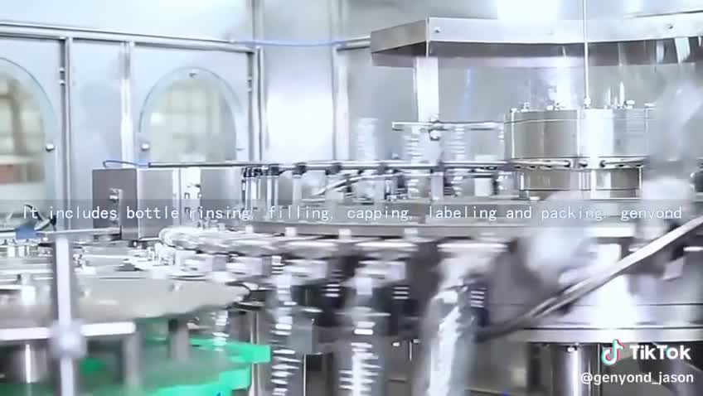

Home
Overview
Training
Capabilities
Contact
Join
Introduction
Problem Statment
Manufacturing performance is heavily impacted by unplanned downtime, which causes noticeable drops in productivity and efficiency. Many factories still lack clear visibility into the real reasons behind these interruptions, making it difficult to identify high-risk operators, machines, or recurring patterns.
Without a reliable way to forecast downtime for the next day, production teams face challenges in scheduling, resource allocation, and maintenance planning. This leads to delayed orders, higher operational costs, and reduced overall performance.
Our project highlights the importance of understanding downtime behavior and building a predictive system that supports smarter, data-driven decision-making.

Slide 6

Home
Overview
Training
Capabilities
Contact
Join
Analyze historical downtime patterns and identify the most influential contributing factors.
Measure downtime behavior across operators, product sizes, flavors, and shifts to highlight high-risk areas.
Build a machine learning regression model to predict downtime minutes per production batch.
Generate a reliable next-day downtime forecast using engineered time-based and operational features.
Objectives
Provide managers with clear, actionable insights** through an interactive dashboard (factors, operators, shift risks).
Deploy predictions via a REST API to enable smooth integration between the model and the dashboard.

Slide 7
Home
Overview
Training
Capabilities
Contact
Join
Utilize historical factory datasets, including batch logs, product specifications, operators, and downtime factors.
Perform comprehensive data cleaning (invalid values, missing data, size standardization, operator normalization).
Apply feature engineering (downtime factor encoding, time features, aggregated batch metrics).
Develop and evaluate multiple ML models (Random Forest, XGBoost) using MAE, RMSE, and R².
Scope
Build a structured deployment pipeline: Model → API Endpoint (/predict) → Interactive Dashboard.
Visualize predictions and insights through a central dashboard covering risk metrics, factor breakdown, and forecasted downtime.

Slide 8
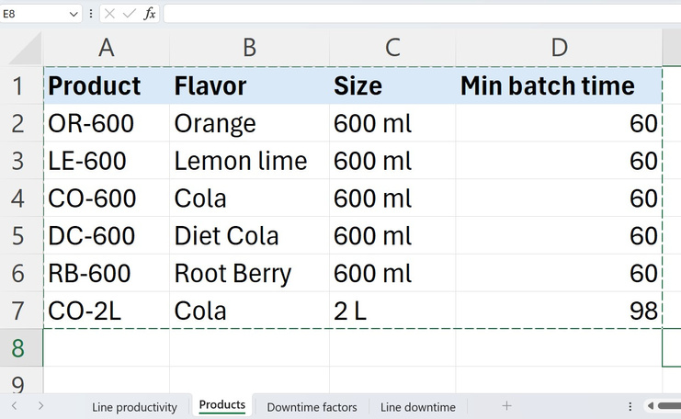
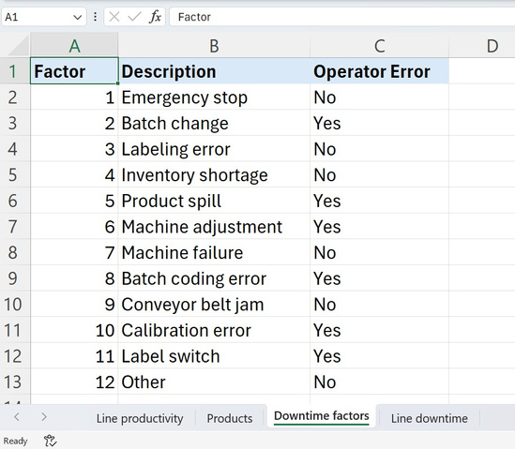
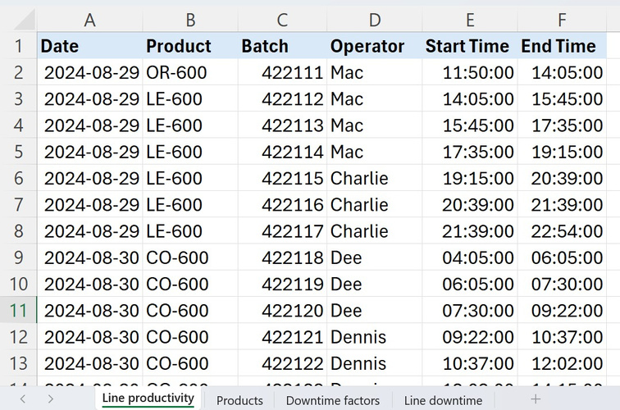
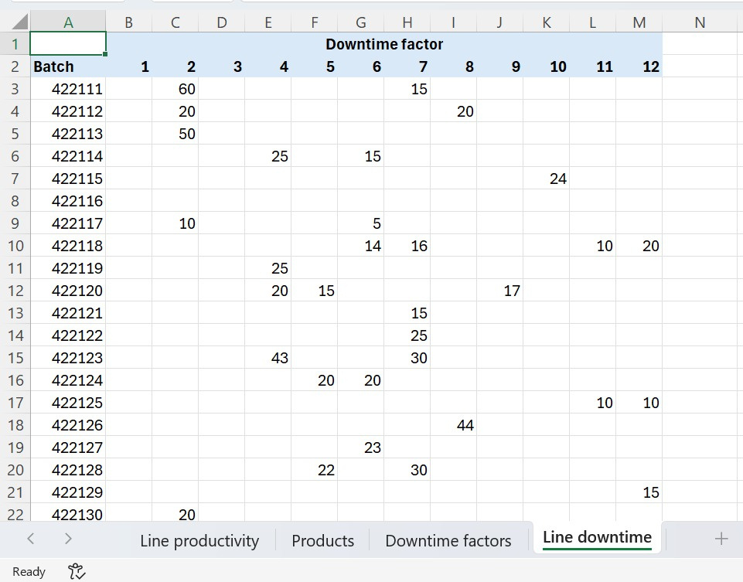
Home
Overview
Training
Capabilities
Contact
Join
Dataset Overview
Data Volume
We worked with 38 production batch records collected from real manufacturing operations.
The data captures product details, operator performance, batch timings, and downtime distributions across multiple factors.

Slide 9
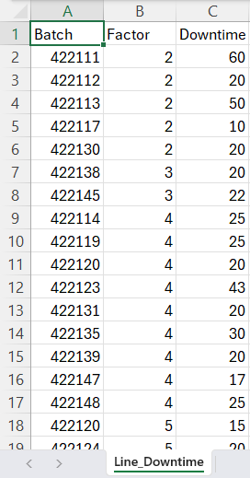

Extracting temporal features (Start Hour, Day of Week) and operator risk metrics (Average Downtime per Operator).
Home
Overview
Training
Capabilities
Contact
Join
Data Preprocessing
Before Handleing & Cleaning
After Handleing & Cleaning

Slide 10
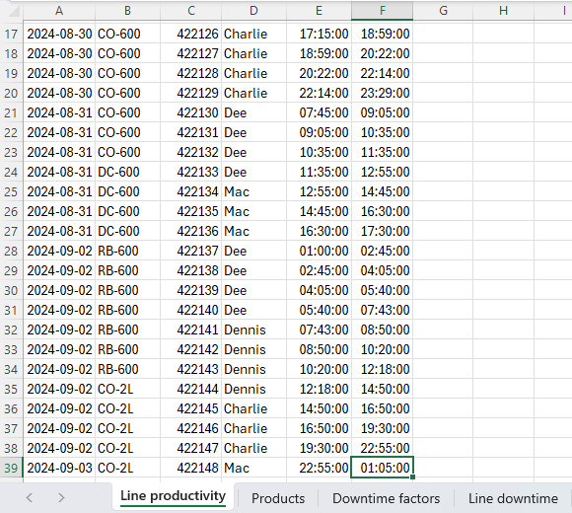
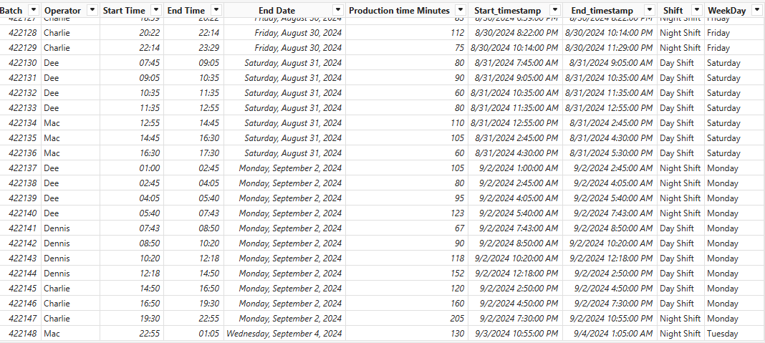
Extracting temporal features (Start Hour, Day of Week) and operator risk metrics (Average Downtime per Operator).
Home
Overview
Training
Capabilities
Contact
Join
Data Preprocessing
Before Handleing & Cleaning
After Handleing & Cleaning

Slide 11
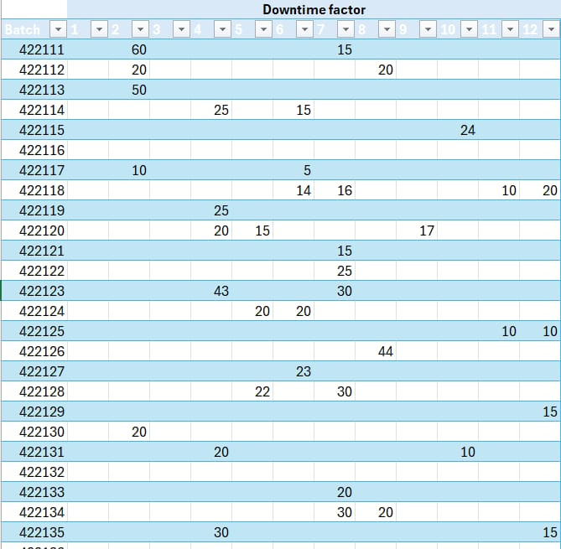
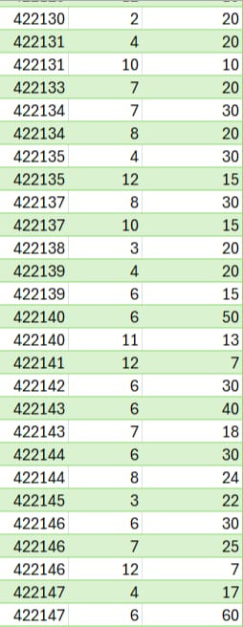
Extracting temporal features (Start Hour, Day of Week) and operator risk metrics (Average Downtime per Operator).
Home
Overview
Training
Capabilities
Contact
Join
Data Preprocessing
Before Handleing & Cleaning
After Handleing & Cleaning

Slide 12
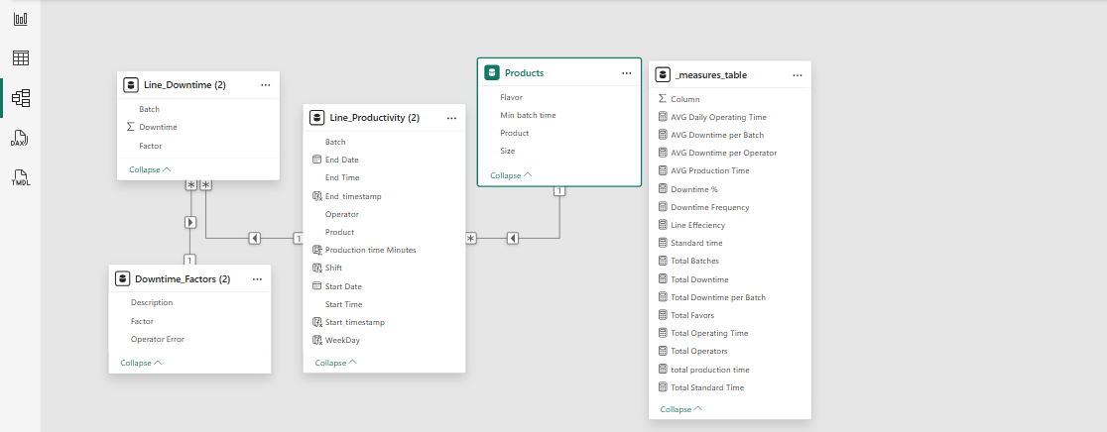
Home
Overview
Training
Capabilities
Extracting temporal features (Start Hour, Day of Week) and operator risk metrics (Average Downtime per Operator).
Contact
Join
Data Preprocessing
Relations betwwen Tables (Power BI)

Slide 13
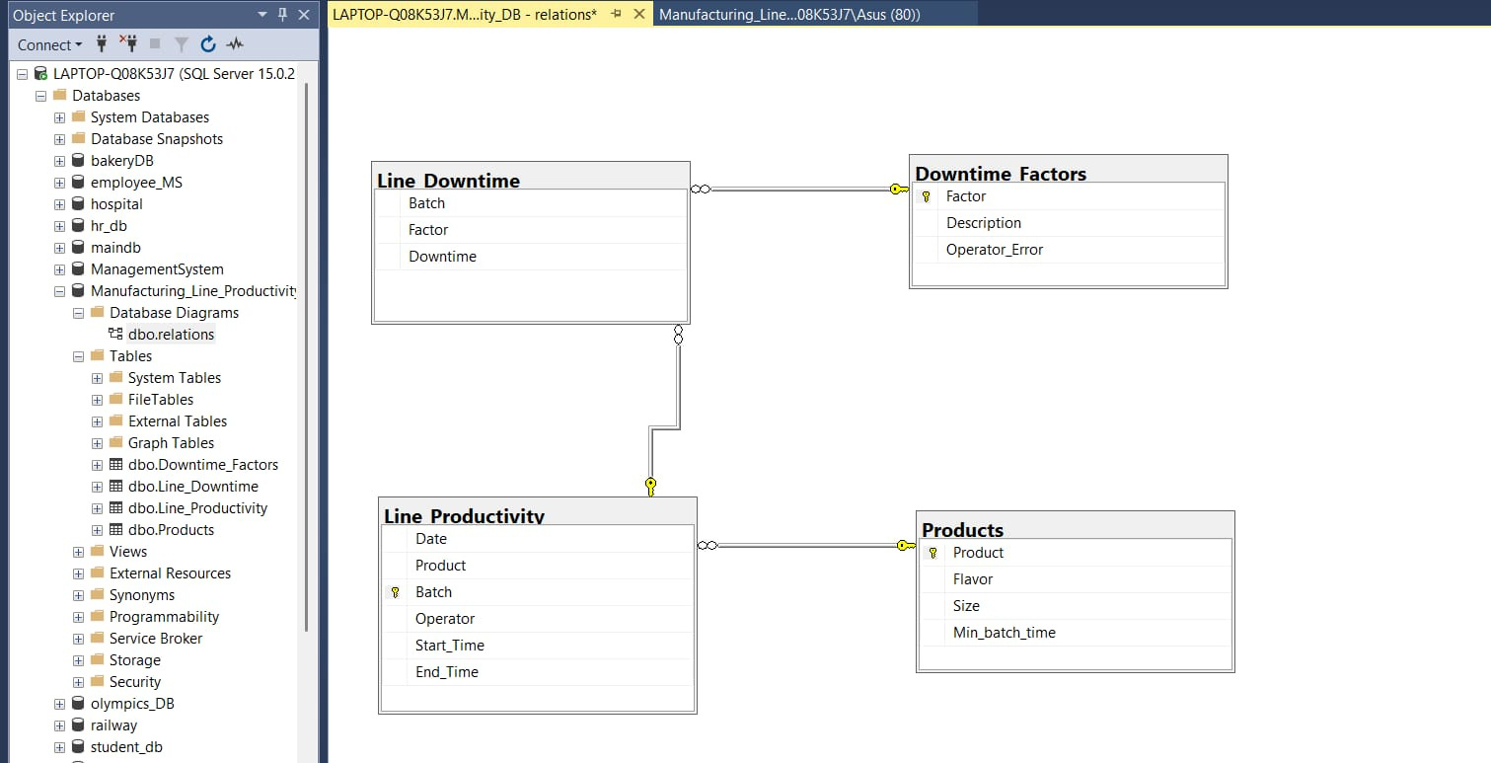
Home
Overview
Training
Capabilities
Contact
Join
Extracting temporal features (Start Hour, Day of Week) and operator risk metrics (Average Downtime per Operator).
Data Modeling
Relations betwwen Tables (SQL)

Slide 14
Home
Overview
Training
Capabilities
Contact
Join
Exploratory Data Analysis-EDA
Operator Distribution
Downtime Factors
Identified the most active operators and highlighted those contributing the highest downtime.
A few factors cause most of the downtime. Mechanical issues, material jams, and changeovers appear most frequently.
Product Analysis
Temporal Analysis
Line Utilization
Larger sizes (600 ml) show higher batch time and downtime. Most produced products also affect total line load.
Downtime varies across days and shifts. Clear peak days with high downtime and others with higher productivity.
Daily runtime fluctuates, and downtime represents a noticeable portion of total production time.

Slide 15



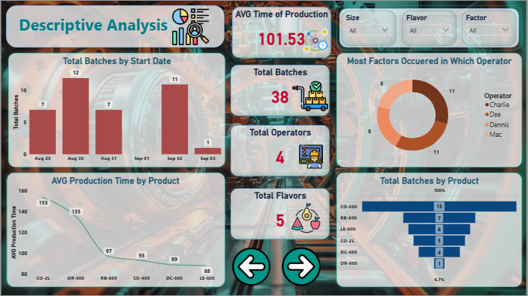
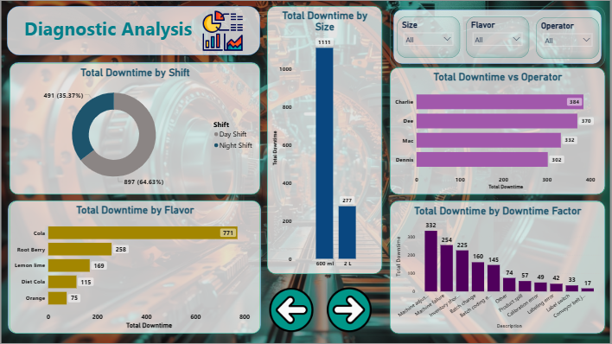
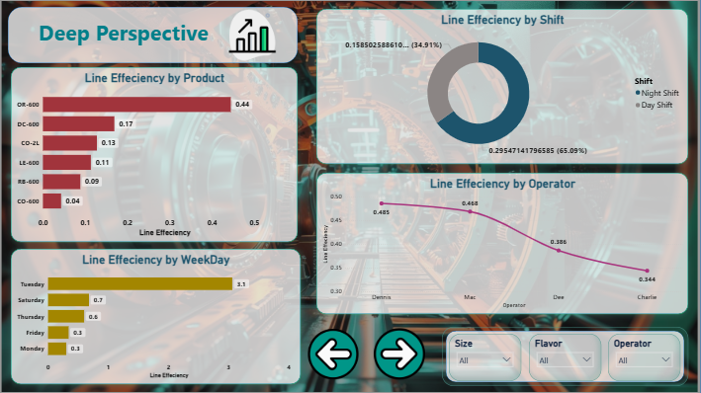
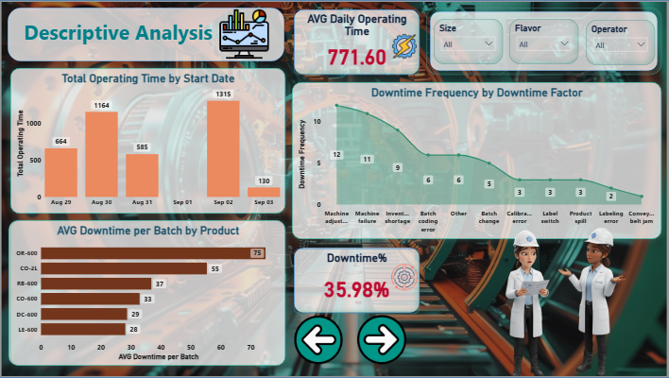
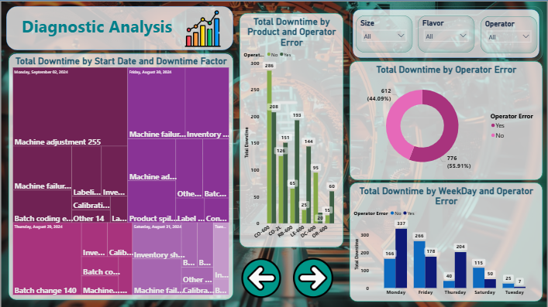
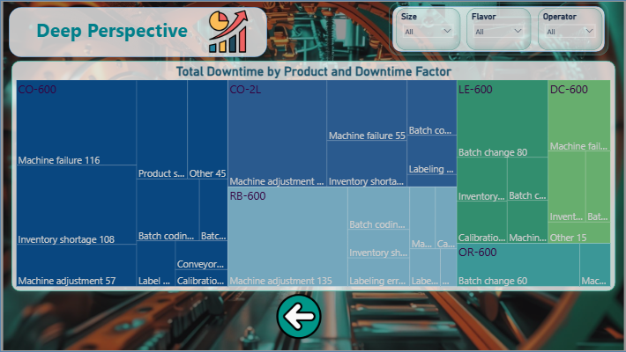
Home
Overview
Training
Capabilities
Contact
Join
Visualization
To see the Analysis clickhere
Discriptive Analysis
Diagnostic Analysis
Deep Perspective

Slide 16

Home
Overview
Training
Capabilities
Contact
Join
AI Chatbot
Overview
Our AI chatbot connects directly to our operational data, allowing users to ask natural-language questions and instantly receive clear, data-driven answers supported by autogenerated charts and insights.
Key Features
Conversational Data Access: Users can query production, downtime, or performance metrics through simple chat prompts.
Automated Visualizations: The chatbot generates tailored charts to illustrate trends, comparisons, or anomalies.
Integrated Dashboard: A unified interface displays key KPIs, recommended actions, and historical insights.
Smart Insights: The system highlights patterns and provides context behind results.

Slide 17
Home
Overview
Training
Capabilities
Contact
Join
Adaptive & Scalable: Learns from user interactions and can expand with future data sources or models.
AI Chatbot
Benefits
Faster Decision-Making: Eliminates manual data searching and speeds up access to critical insights.
Improved Accuracy: Reduces human interpretation errors by using consistent, up-to-date data sources.
User-Friendly: Accessible for both technical and non-technical staff, promoting wider data adoption.
Adaptive & Scalable: Learns from user interactions and can expand with future data sources or models.

Slide 18

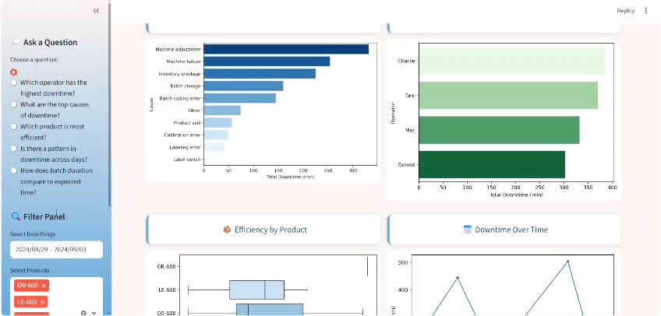
Rimberio
Home
Overview
Training
Capabilities
Contact
Join
AI Chatbot

Slide 19

Home
Overview
Training
Capabilities
Contact
Join
Data Preprocessing
for ML
Data Merging
Feature Engineering
Three primary tables were joined using Batch ID and Product ID.
Extracting temporal features (Start Hour, Day of Week) and operator risk metrics (Average Downtime per Operator).
Datetime Handling
Correcting "Overnight Batches" (where End Time < Start Time) and calculating the actual Batch Duration in minutes.
Statistical Treatment
Converting size formats and handling Missing Values (by filling downtime factors with zero).
Target Aggregation
Three primary tables were joined using Batch ID and Product ID.

Slide 20

Home
Overview
Training
Capabilities
Contact
Join
Machine Learning Model
Overview:
The Machine Learning module predicts Duration Deviation — how many minutes the next batch is expected to be delayed.
It uses advanced engineered features that capture operator behavior, downtime patterns, product complexity, and time-based performance signals.

Slide 21
Home
Overview
Training
Capabilities
Contact
Join
Machine Learning Model
Key Features:
• Predictive modeling using a Random Forest Regressor
• Uses 10+ engineered features such as:
– Lagged downtime history
– Operator-product interaction behaviors
– Micro-stops and incident frequency
– High-risk failure indicators
– Operator fatigue sequence
• Encodes categorical variables to numerical vectors
• Evaluated using MAE, R², and 5-Fold Cross-Validation

Slide 22
Home
Overview
Training
Capabilities
Contact
Join
Machine Learning Model
Benefits:
• Predicts delays before they happen
• Enhances production planning and scheduling accuracy
• Identifies high-risk operators and batches
• Reduces unplanned downtime and improves line efficiency
• Supports data-driven decision making at the factory floor

Slide 23

Home
Overview
Training
Capabilities
Contact
Join
Planning Accuracy
Daily downtime forecasting improves scheduling.
Estimated reduction in unplanned delays: ~12–15%.
Most productive day: [most_productive_day], helps optimize batch assignments.
Early Risk Detection
Flags high-risk operators and lines.
Top operators by batch count: [top 3 operators].
Early alerts prevent large cycle time deviations.
Maintenance Prioritization
Focus on most impactful downtime factors.
Top factors by incidents: [list top factors].
Enables proactive maintenance, reducing reactive fixes.
Business Impact
Analysis Automation
Saves hours of manual reporting.
Interactive dashboards visualize: operator downtime, product-size effects, temporal patterns, and 12-factor breakdown.

Slide 24

Home
Overview
Training
Capabilities
Contact
Join
Data Quality:
Inconsistent formats and occasional errors in recording batch start/end times, affecting analysis and prediction accuracy.
Imbalanced Data:
Majority of batches have zero downtime, while a few have significant downtime.
Makes regression model training challenging, as large downtime values are rare compared to zeros.
Lack of Real-Time Data:
All data is post-event logs rather than live sensor streams.
Limits the ability to detect high-risk batches or lines in real time.
Challenges
Limited Historical Data (Data Set) :
Available historical records cover a restricted time period.
Reduces the model’s ability to learn rare downtime patterns.
More historical data would improve predictive accuracy.

Slide 25

Home
Overview
Training
Capabilities
Contact
Join
To Solve these problems:
Solutions
Robust Cleaning Pipeline:
Implementing specific logic to handle overnight times and standardize text-based data (Operators, Sizes).
Advanced Feature Engineering:
Strong Model Selection:
Creation of aggregated statistical features (e.g., historical average downtime per operator) to boost prediction accuracy.
Utilizing robust tree-based algorithms (like XGBoost) for their resilience and ability to handle feature complexity.
Integrated Deployment:
Transitioning the project from a notebook to a practical tool via API and an interactive dashboard.

Slide 26


Home
Overview
Training
Capabilities
Contact
Join
Limitations
Disadvantages
The project covers a limited historical period, which may not capture rare downtime events, causing model accuracy to drop on unseen or unusual failure modes. Data quality issues, such as inconsistent start/end times, and reliance on post-event logs instead of real-time sensors, can affect predictions. Manual operator inputs introduce potential human error and variability, while the high prevalence of zero-downtime batches makes predicting extreme cases more challenging.

Slide 27
Home
Overview
Training
Capabilities
Contact
Join
Limitations
Disadvantages
Real-World Operational Challenges:
In practice, production lines face unexpected machine breakdowns, operator fatigue, and supply chain disruptions that are not captured in historical data. Coordination between maintenance, operations, and quality teams can also cause delays and reduce overall efficiency.

Slide 28

Home
Overview
Training
Capabilities
Contact
Join
Efficient and Sustainable Recommendations
Implement preventive maintenance schedules guided by model insights to reduce unplanned downtime.
Provide operator training programs focused on high-risk tasks identified by the predictive model.
Establish standardized data collection processes for more consistent and high-quality inputs.
Recommendations
Continuously monitor model performance and update the system based on real-world deviations.

Slide 29

Home
Overview
Training
Capabilities
Contact
Join
Conclusion
This project showcases the true power of combining data, machine learning, and operational knowledge. By meticulously analyzing historical production and downtime data, we built a predictive model that estimates total downtime per batch, helping operators and managers act proactively.
Finally
Beyond the model, we developed an interactive dashboard to visualize trends, monitor key metrics, and deliver actionable insights. To further enhance operational support, we also implemented a chatbot capable of answering queries and guiding decisions in real-time.
This project reflects not only the power of our predictive models and dashboards but also the dedication and teamwork behind every insight. It showcases how our combined effort transforms raw production data into actionable, real-world solutions.

Slide 30

Home
Overview
Training
Capabilities
Contact
Join
Thank You

